Slide 1



Physical Pharmacy
(CPT 203/ PT 203)
Lab 11
Buffer & Adsorption

Slide 2
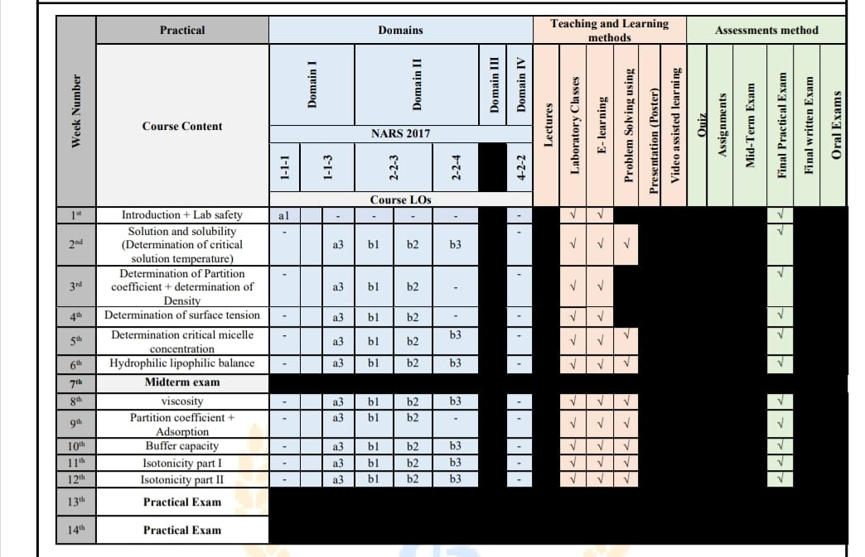

Slide 3


Slide 4
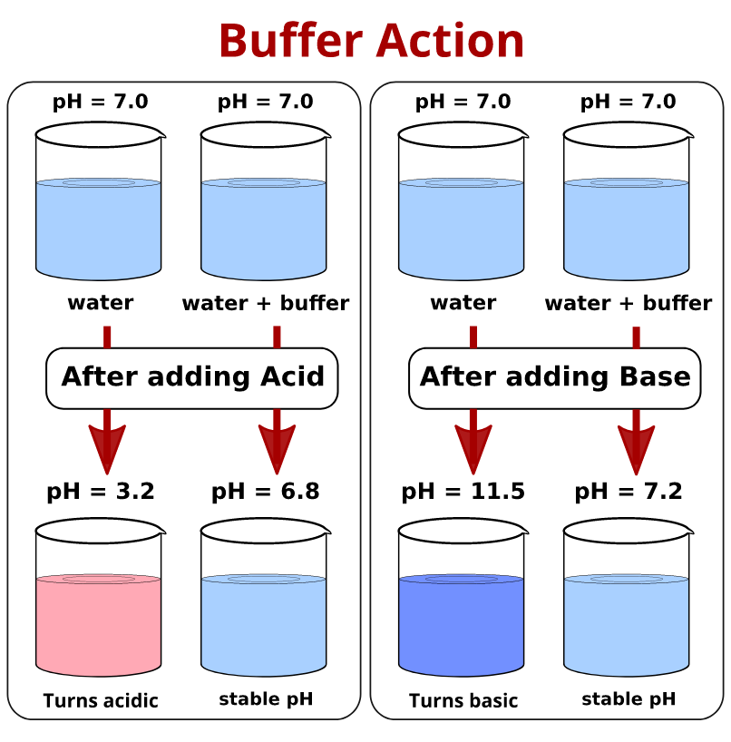
Buffers and Buffer solutions
Buffer solution: is a system, usually an aqueous solution, that possesses the property of resisting changes in pH with the addition of small amounts of a strong acid or base.
Buffer capacity: the ability of a solution to resist rapid changes in pH.
Typical buffer systems that may be used in pharmaceutical formulations include the following pairs: "acetic acid and sodium acetate"," boric acid and sodium borate", and "disodium phosphate and sodium acid phosphate".

Slide 5
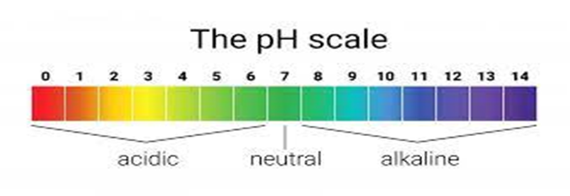
Dissociation of water
The dissociation of water can be represented by:
H2O H⁺ + OH⁻
In pure water the concentrations of H⁺ and OH⁻ ions are equal and at 25°C both have the values of 1 x 10⁻⁷ mol/l.
pH
the negative logarithm of the hydrogen Ion concentration [H+]
pH = -log [H+]
pH of a neutral solution like pure water is 7, why?
because the conc. of H+ ions (and OH- ) ions = 1 x 10⁻⁷ mol/l (-log 10⁻⁷= 7)
pHs of acidic solutions will be less than 7
pHs of alkaline solutions will be greater than 7

Slide 6
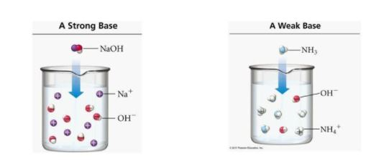
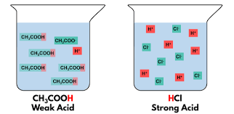
Dissociation (or ionization) constants and pKa:
In solutions of weak acids or weak bases equilibrium exist between undissociated molecules and their ions.
Such equilibrium do not occur in solutions of strong acids or bases in water, why? because they are completely ionized.

Slide 7
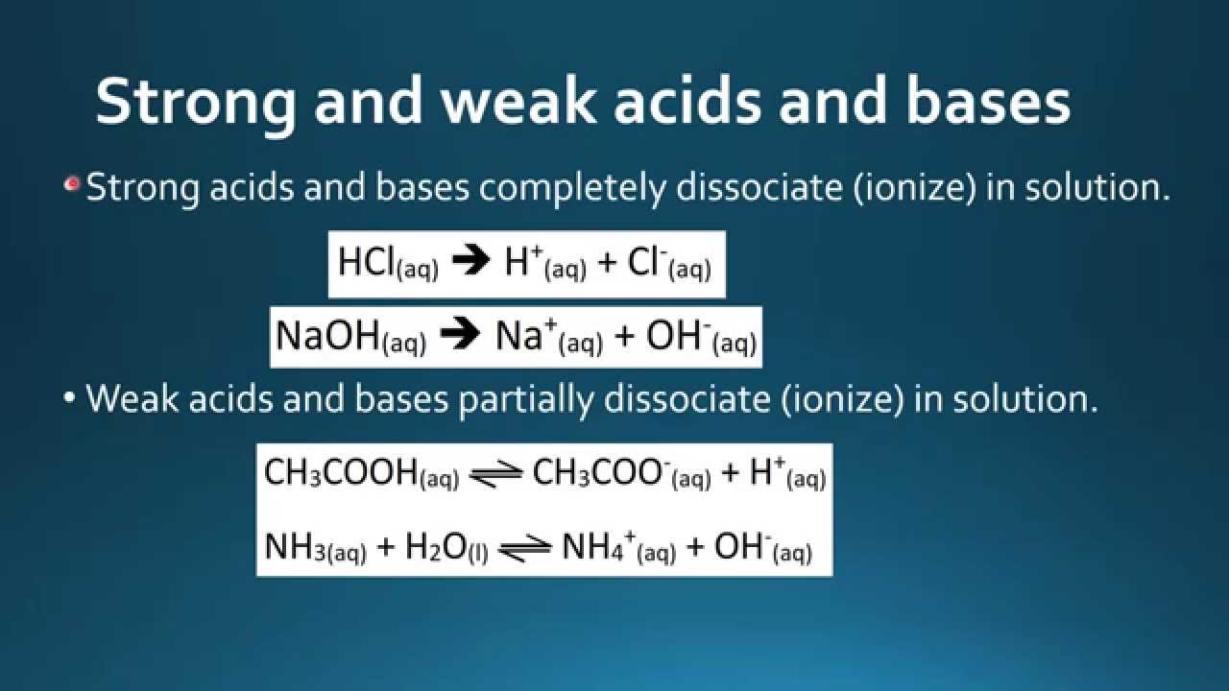

Slide 8
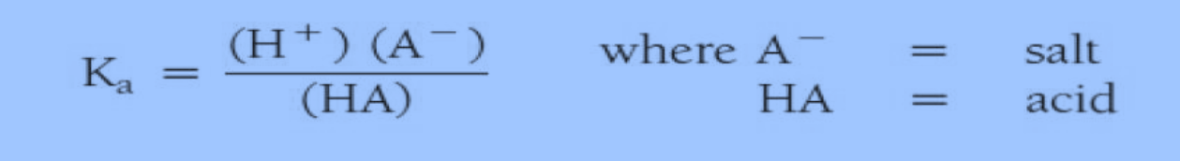
Dissociation (or ionization) constants and pKa:
In a solution of a weakly acidic drug HA the equilibrium may be represented by: HA H⁺ + A⁻
The protonation of a weakly basic drug B can be represented by :
B + H⁺ BH⁺
The ionization constant (dissociation constant) Ka of a weak acid can be obtained by applying the Law of Mass Action:

Slide 9
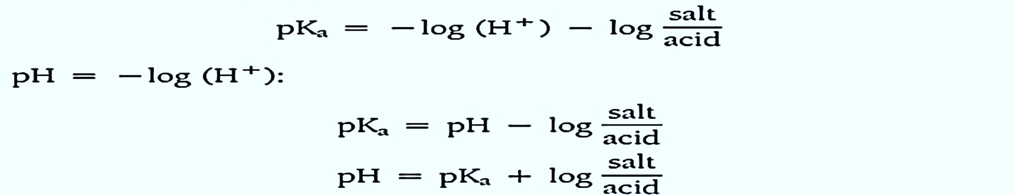
pK_{a} = the negative logarithm of K_{a}
pH = the negative logarithm of the hydrogen ion conc. [H⁺]
Henderson-Hasselbalch equation:
A general equation that is applicable to any acidic drug with one ionizable group where:
C_{u} = conc. of the unionized ; C_{i} = conc. of the ionized species
C_{i}
pK_{a} = pH - log
C_{u}

Slide 10
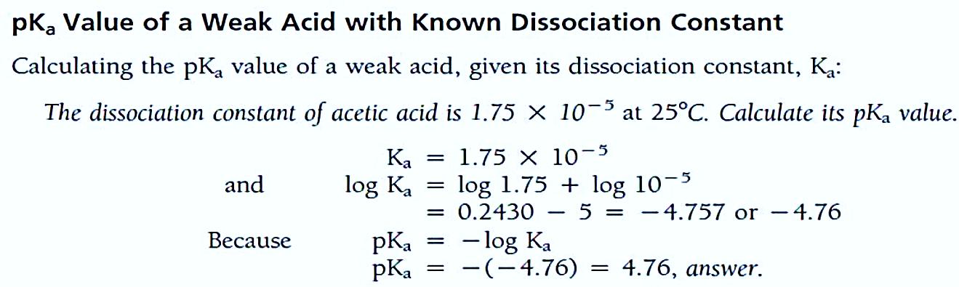
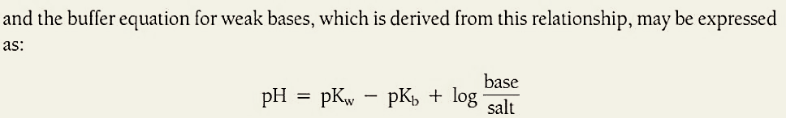
Buffer equations for weak bases
For weak base:
Where pK_{w} of water = (14 ) & K_{w} of water = (1 x 10⁻¹⁴)

Slide 11
Problem 1
The pK_{a} of the weakly acidic drug sulphapyridine is about 8.0 and if the pH of the lacrimal fluid is 7.2; find the ratio of
ionized: unionized drug?
C_{i}
log = pH - pK_{a} = 7.2 - 8 = -0.8
C_{u}
C_{i}/C_{u} = antilog(- 0.8) = 0.158 :1
Ci
pKa = pH - log
Cu

Slide 12
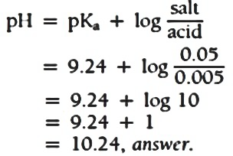
Problem 2
2. What is the pH of a buffer solution prepared with 0.05 M sodium borate and 0.005 M boric acid? The pKa value of boric acid is 9.24 at 25ºC?
213.796 : 1

Slide 13
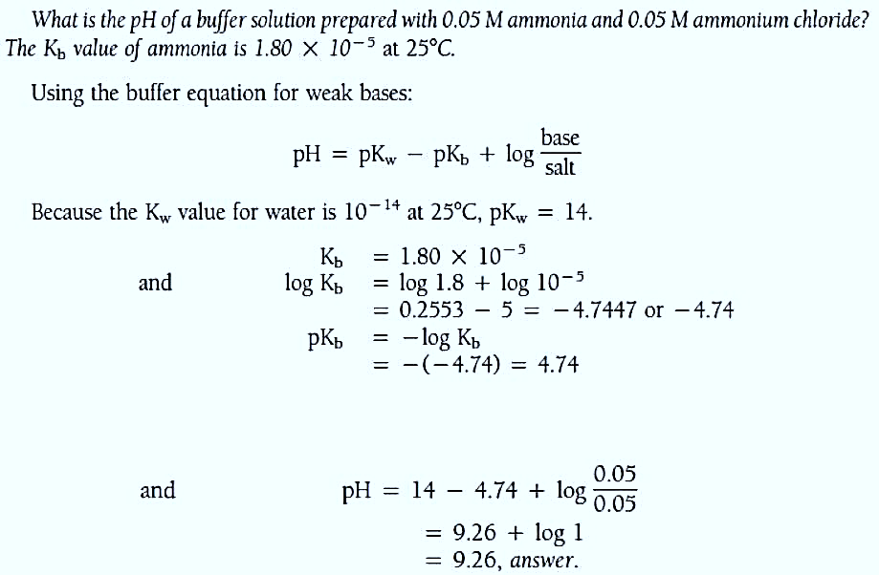
Problem 3

Slide 14
Activity
1) If acetic acid acetate buffer is prepared containing 1.00 M acetic acid and 1.00 M sodium acetate. (pK_{a} of acetic acid is 4.752);What is its pH?
2) Calculate the pH of a buffer solution composed of 0.700 M formic acid (HCOOH, K_{a} = 1.77 x 10¯⁴) and 0.500 M sodium formate (HCOONa).

Slide 15
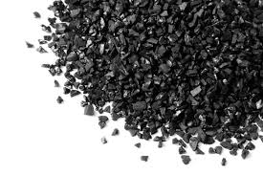
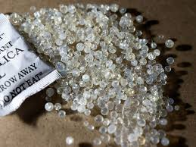
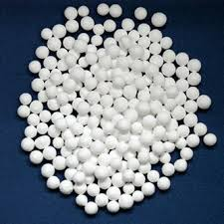
Adsorption
Adsorption: is the process where molecules are held at the surface of a solid. This phenomenon occurs on solid surfaces to reduce surface free energy, and at liquid interfaces to reduce interfacial tension
Adsorbent: The substance on the surface of which adsorption takes place.
Adsorbate: The substance which is being adsorbed on the surface of another substance.
Desorption: The process of removal of an adsorbed substance from the surface on which it is adsorbed
Examples of common adsorbent materials
Activated Carbon.
Activated Alumina.
Silica Gel.

Slide 16
Types of Adsorption
Positive Adsorption: Occurs when the concentration of adsorbate is higher on the surface of adsorbent than in the bulk.
Negative Adsorption: Occurs when the concentration of adsorbate is less on the surface of adsorbent than in the bulk.
Factors affecting Adsorption
Effect of adsorbate: The easily liquifiable gases NH3, HCl, CO2 are adsorbed to a greater extent than the permanent gases such as H2, O2, N2 .
Effect of temperature: Adsorption decreases with increase in temperature.
Effect of pressure: An increase in pressure causes an increase in the magnitude of adsorption of an adsorbent.
Notes:
Adsorption generally decreases with high temperatures ,because it is an exothermic process (releases heat) and increasing temperature provides enough energy for the adsorbed molecules to escape the surface, a process known as desorption.

Slide 17
Frendlich Isotherm Equation
Freundlich Isotherm :
Proposed by Herbert Freundlich (1906).
Describes adsorption on heterogeneous surfaces (multilayer adsorption) : It assumes that the surface has varied adsorption sites with different adsorption energies.
Excellent for intermediate concentration & pressure ranges.
Limitations of Freundlich isotherm
Fails at very high pressures or concentrations.
Does not account for true multilayer adsorption coverage at saturation.

Slide 18
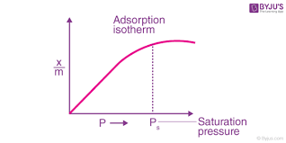
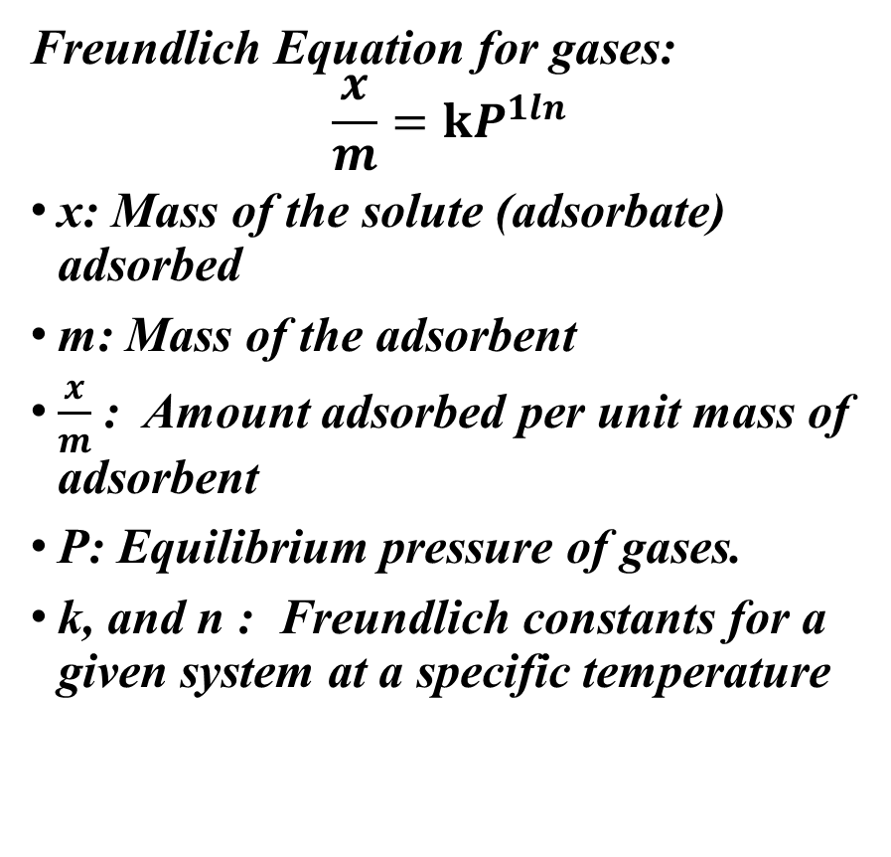
Frendlich Isotherm Equation (For gases)
Freundlich Equation for gases:
$$\frac{x}{m}=kP^{1ln}$$
x: Mass of the solute (adsorbate) adsorbed
m: Mass of the adsorbent
$\frac{x}{m}$ : Amount adsorbed per unit mass of adsorbent
P: Equilibrium pressure of gases.
k, and n : Freundlich constants for a given system at a specific temperature

Slide 19
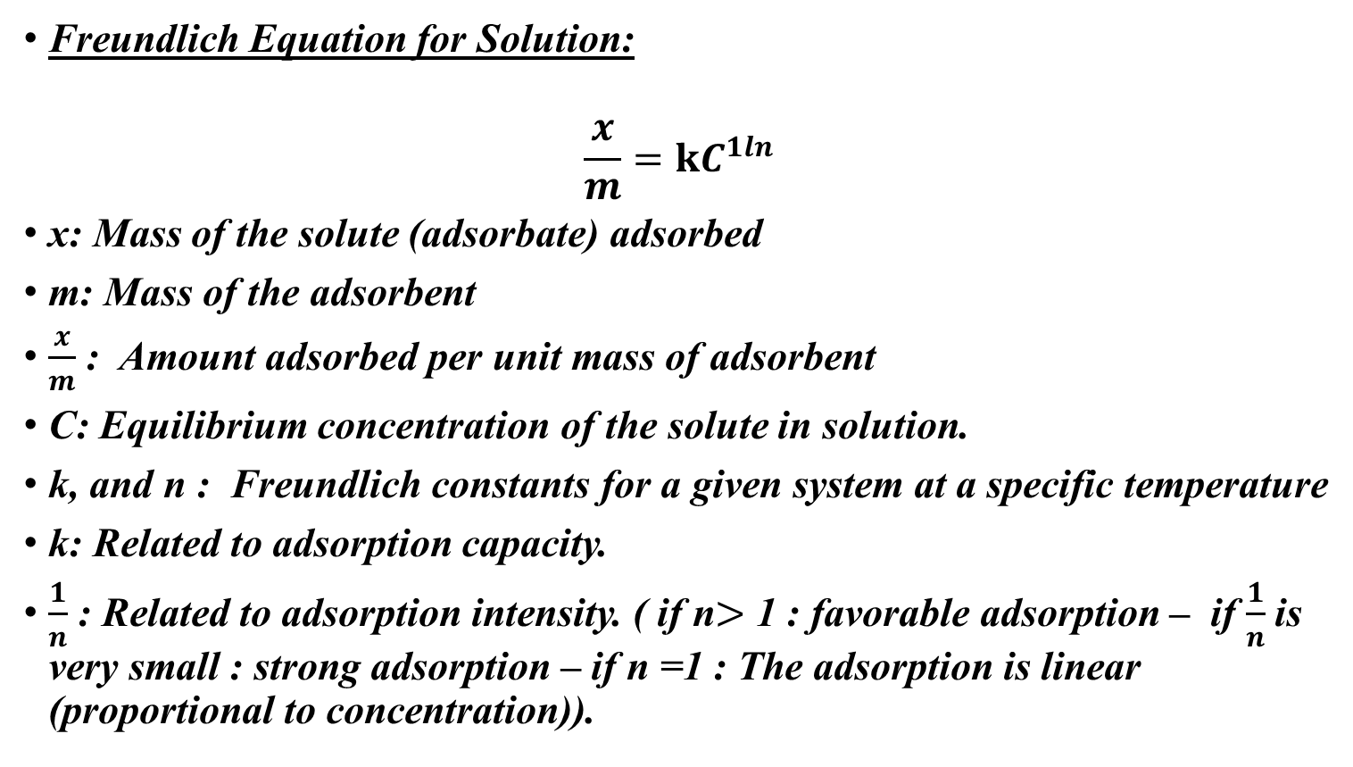
Freundlich Isotherm Equation (For liquids)
Freundlich Equation for Solution:
$$\frac{x}{m}=kC^{1ln}$$
x: Mass of the solute (adsorbate) adsorbed
m: Mass of the adsorbent
$\frac{x}{m}$ : Amount adsorbed per unit mass of adsorbent
C: Equilibrium concentration of the solute in solution.
k, and n : Freundlich constants for a given system at a specific temperature
k: Related to adsorption capacity.
$\frac{1}{n}$ : Related to adsorption intensity. ( if n$>$ 1 : favorable adsorption – if $\frac{1}{n}$is very small : strong adsorption – if n =1 : The adsorption is linear (proportional to concentration)).
Notes:
K :Adsorption Capacity :
Higher k indicates a higher amount of solute can be adsorbed per unit mass.
1/n: Adsorption Intensity:
Measures how strongly the adsorbate is bound and whether the process is favorable.

Slide 20
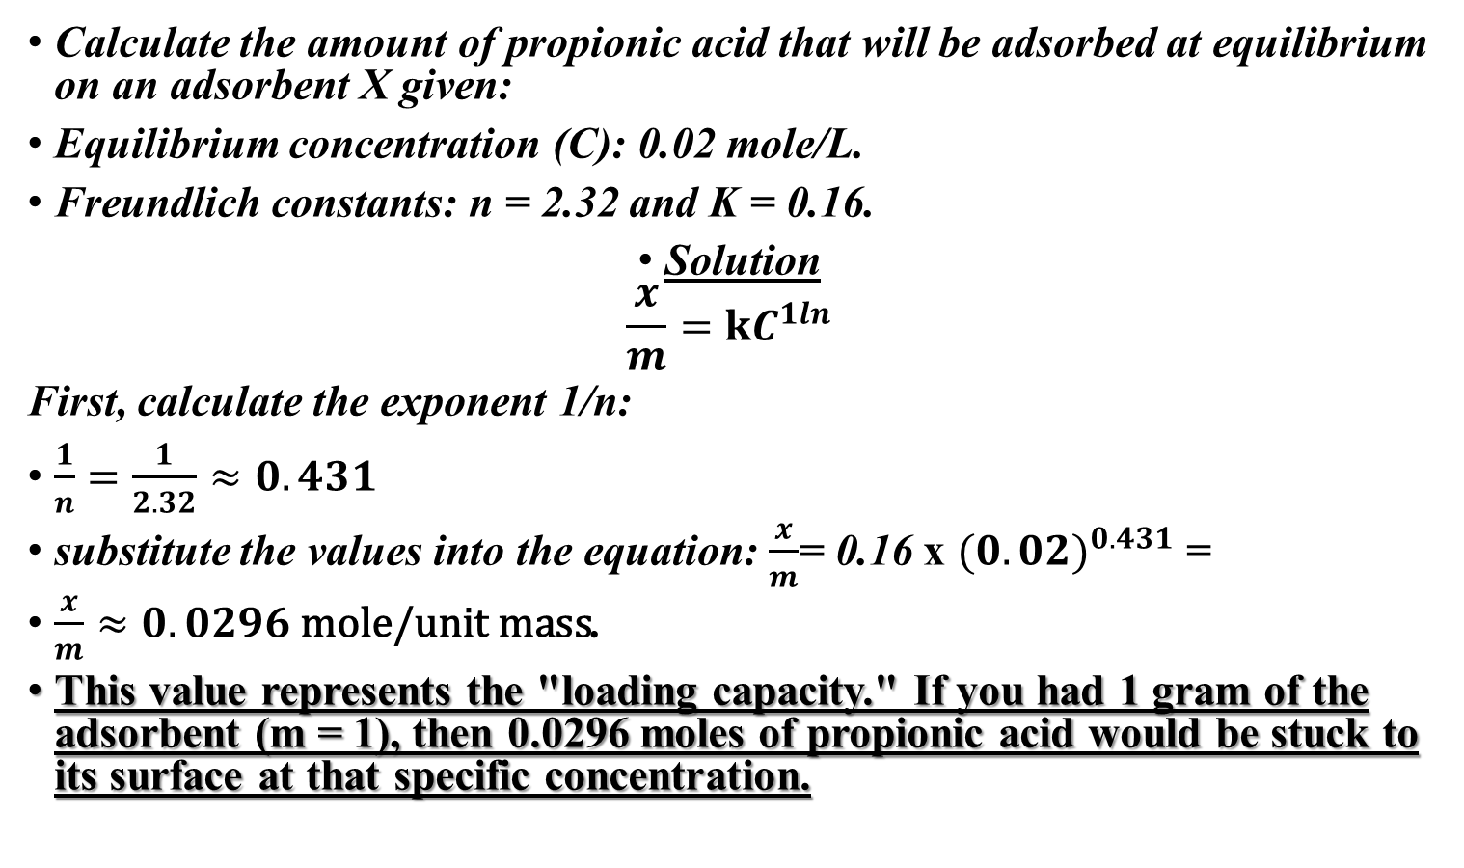
Freundlich isotherm activity
Calculate the amount of propionic acid that will be adsorbed at equilibrium on an adsorbent X given:
Equilibrium concentration (C): 0.02 mole/L.
Freundlich constants: n = 2.32 and K = 0.16.
Solution
$$\frac{x}{m}=kC^{1ln}$$
First, calculate the exponent 1/n:
$\frac{1}{n}=\frac{1}{2.32}≈0.431$
substitute the values into the equation: $\frac{x}{m}$= 0.16 x ${(0.02)}^{0.431}$ =
$\frac{x}{m}≈0.0296 \text{mole}\text{/}\text{unit} \text{mass}$.
This value represents the "loading capacity." If you had 1 gram of the adsorbent (m = 1), then 0.0296 moles of propionic acid would be stuck to its surface at that specific concentration.

Slide 21
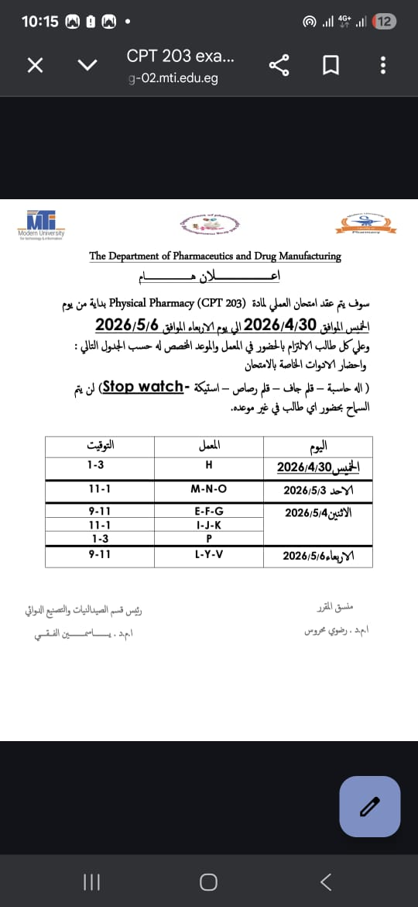

Slide 22


Slide 23


